Slide 1





The Database and Data Integration (WP2)
Bruno Colas, Linda Angulo Lopez, Isabelle Baly
TRANSLOC Scientific Workshop, 10-12 September 2025

Slide 2
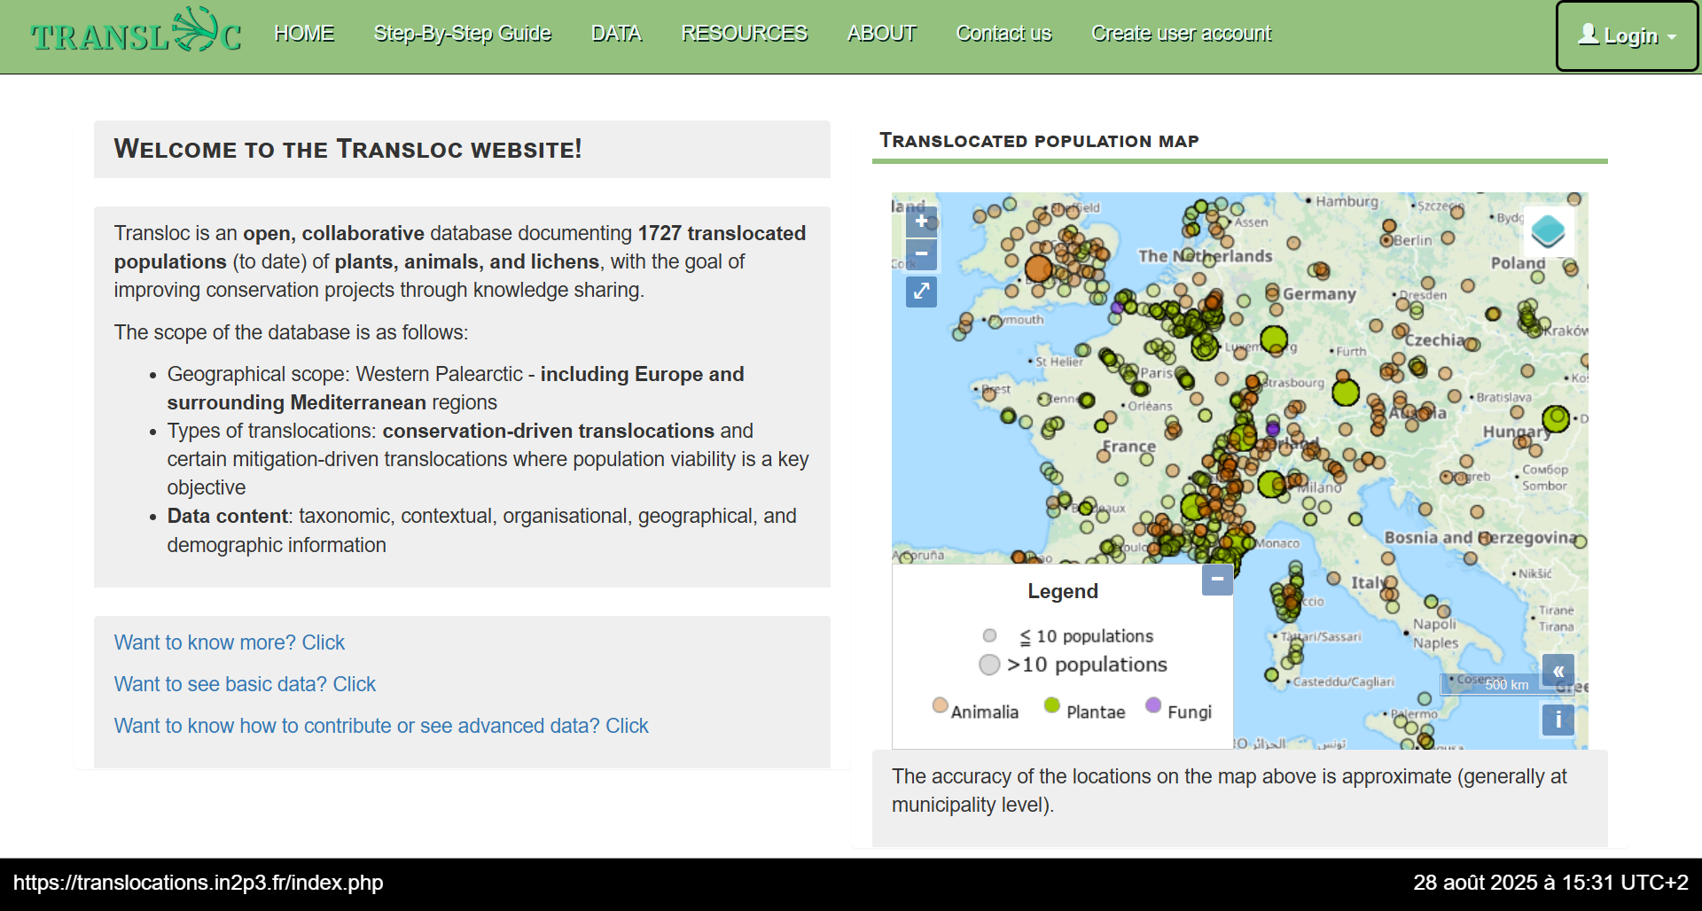
Landing page

Slide 3
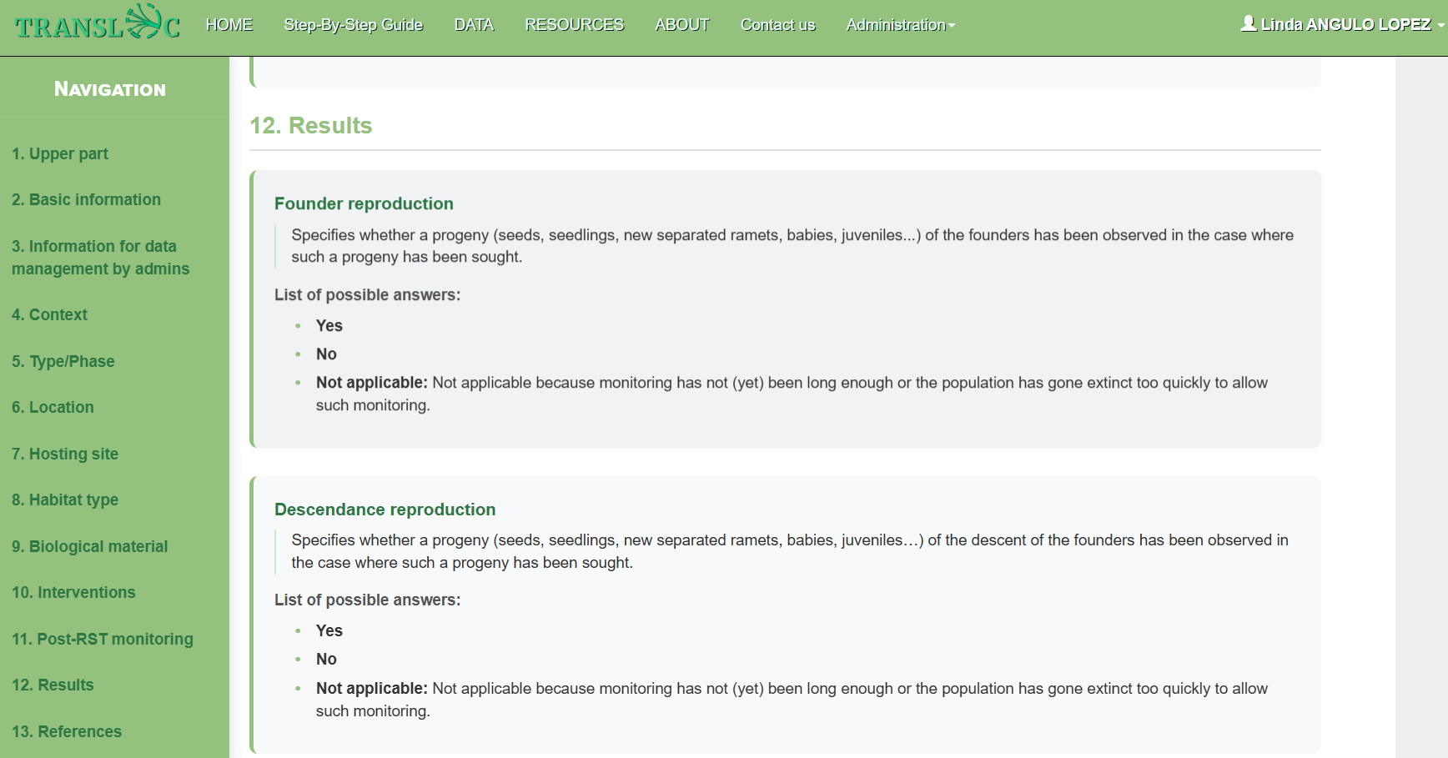
Data Field Definitions

Slide 4
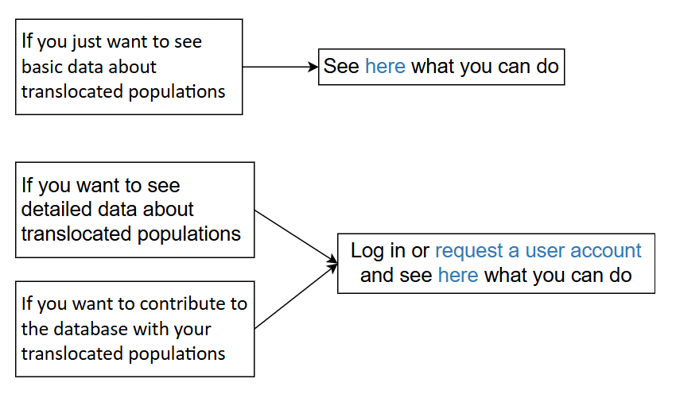
Step-by-step Guide - Visitor

Slide 5
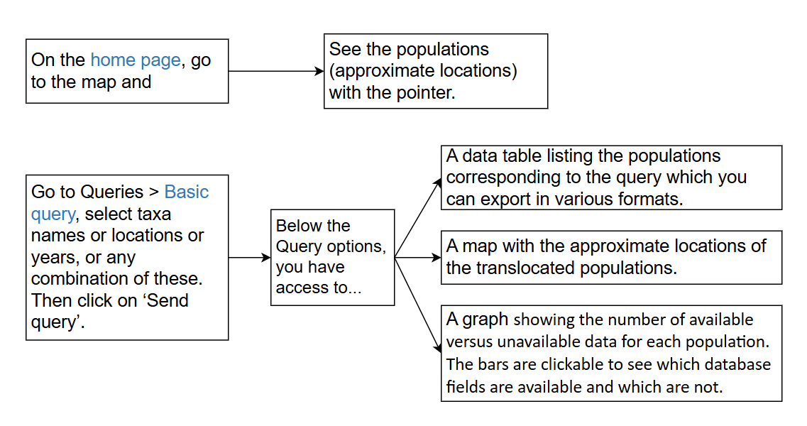
Step-by-step Guide - Visitors Can

Slide 6
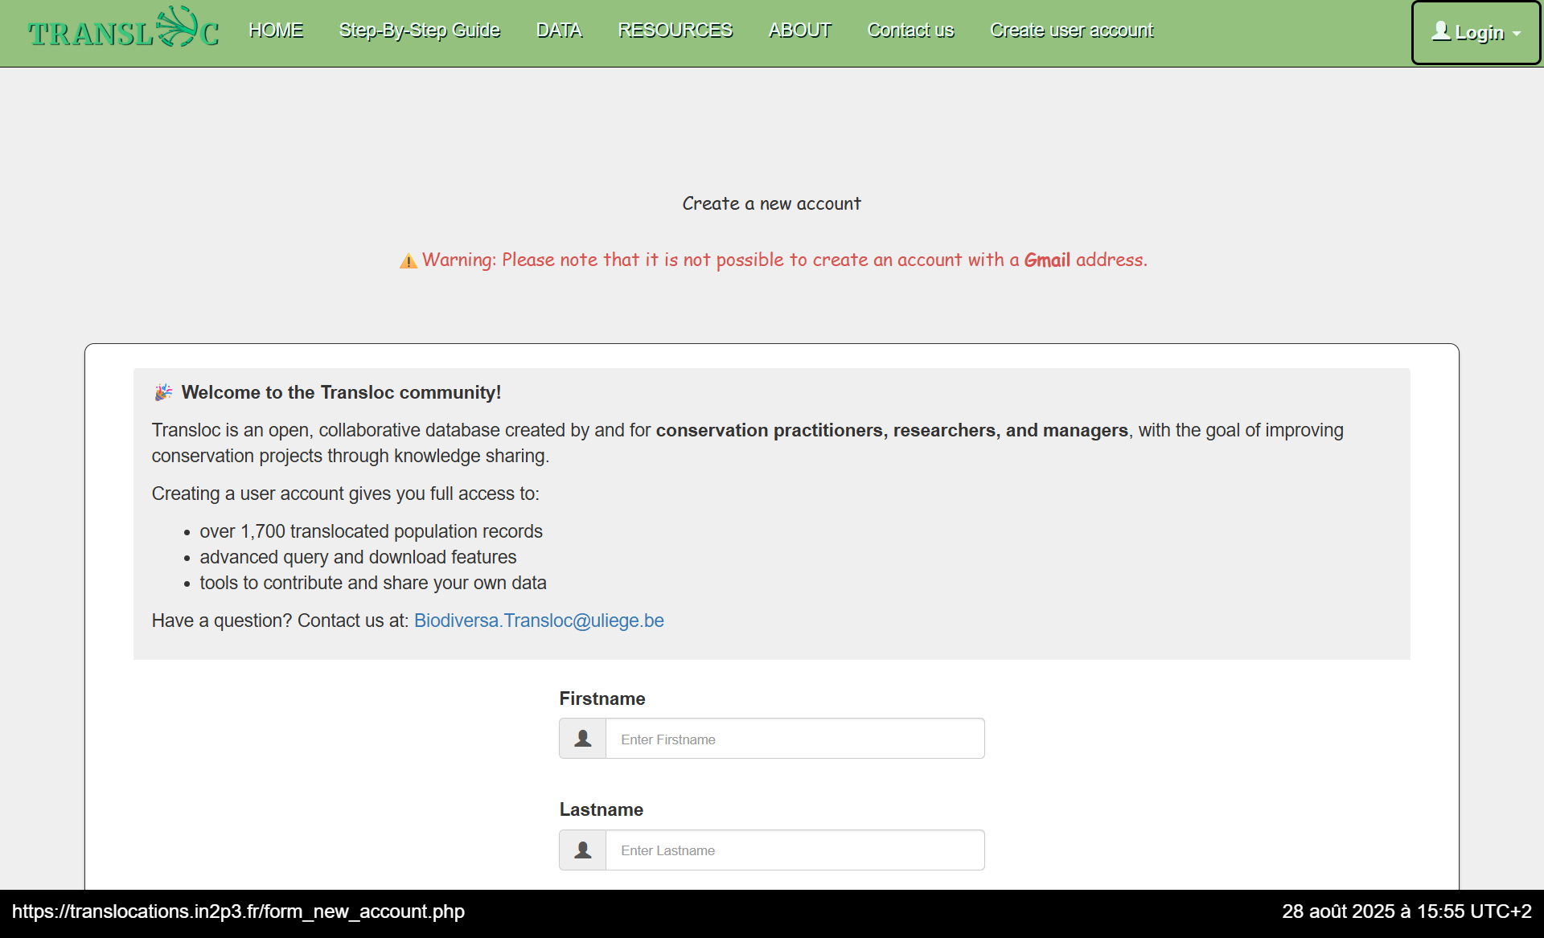
Request Contributor Access

Slide 7
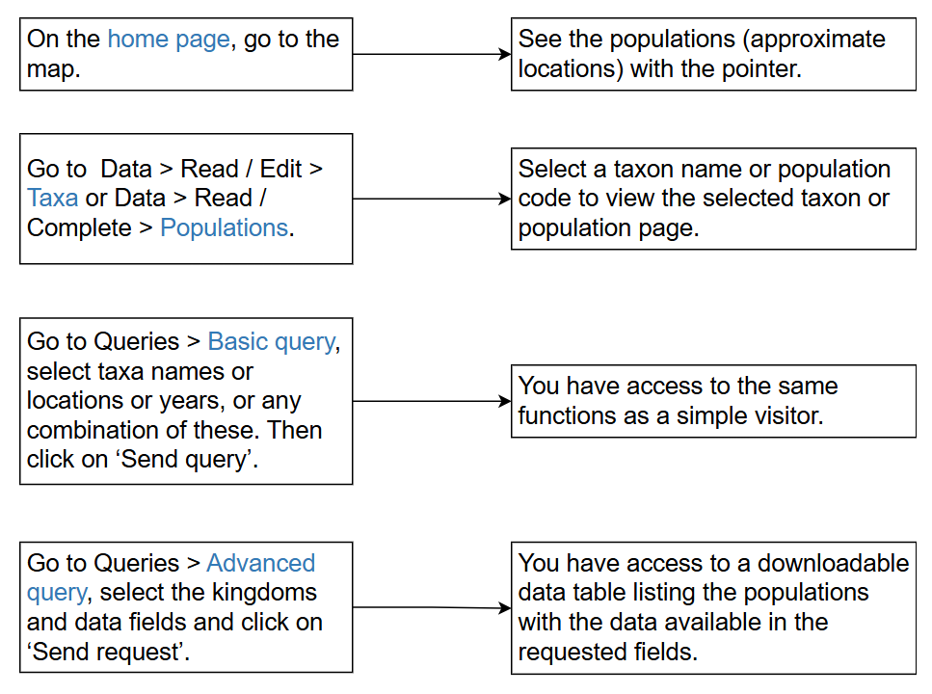
Contributor - Advanced Query

Slide 8
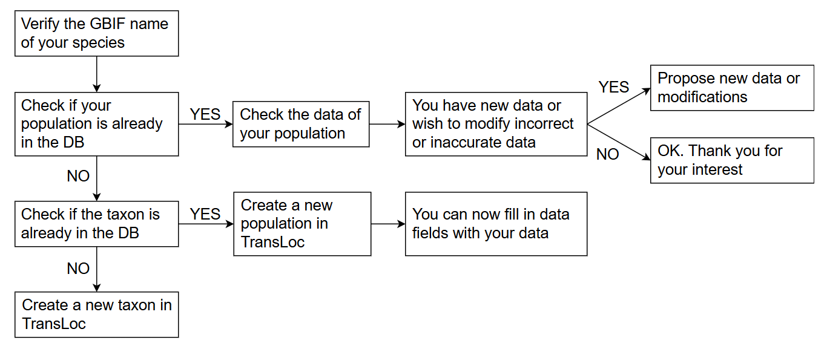
How to Contribute

Slide 9
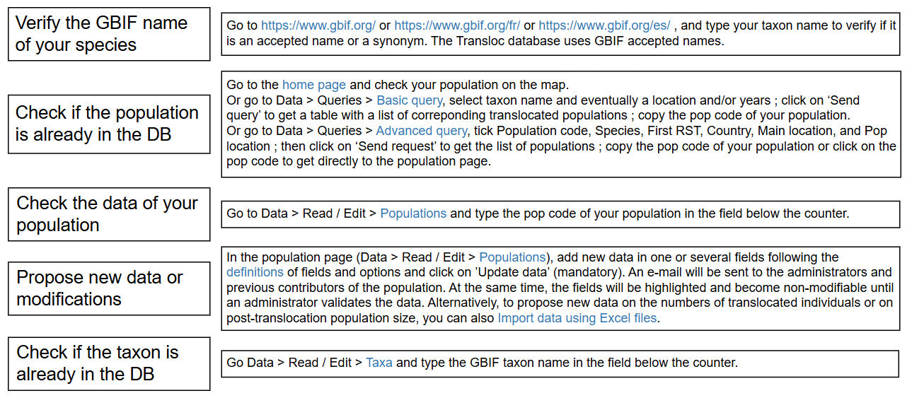
Contributor - Data Quality Checks

Slide 10

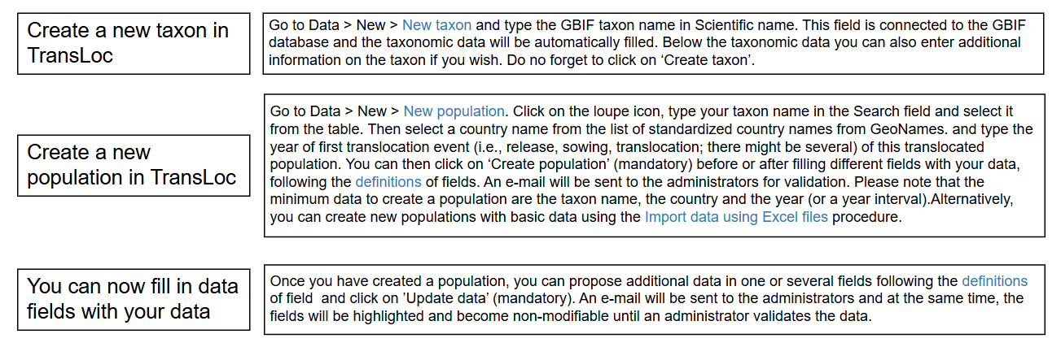
Contributors can Add Data
After uploading, data will be highlighted in yellow on the Transloc website until administrator validation - this data cannot be modified until moderated.

Slide 11
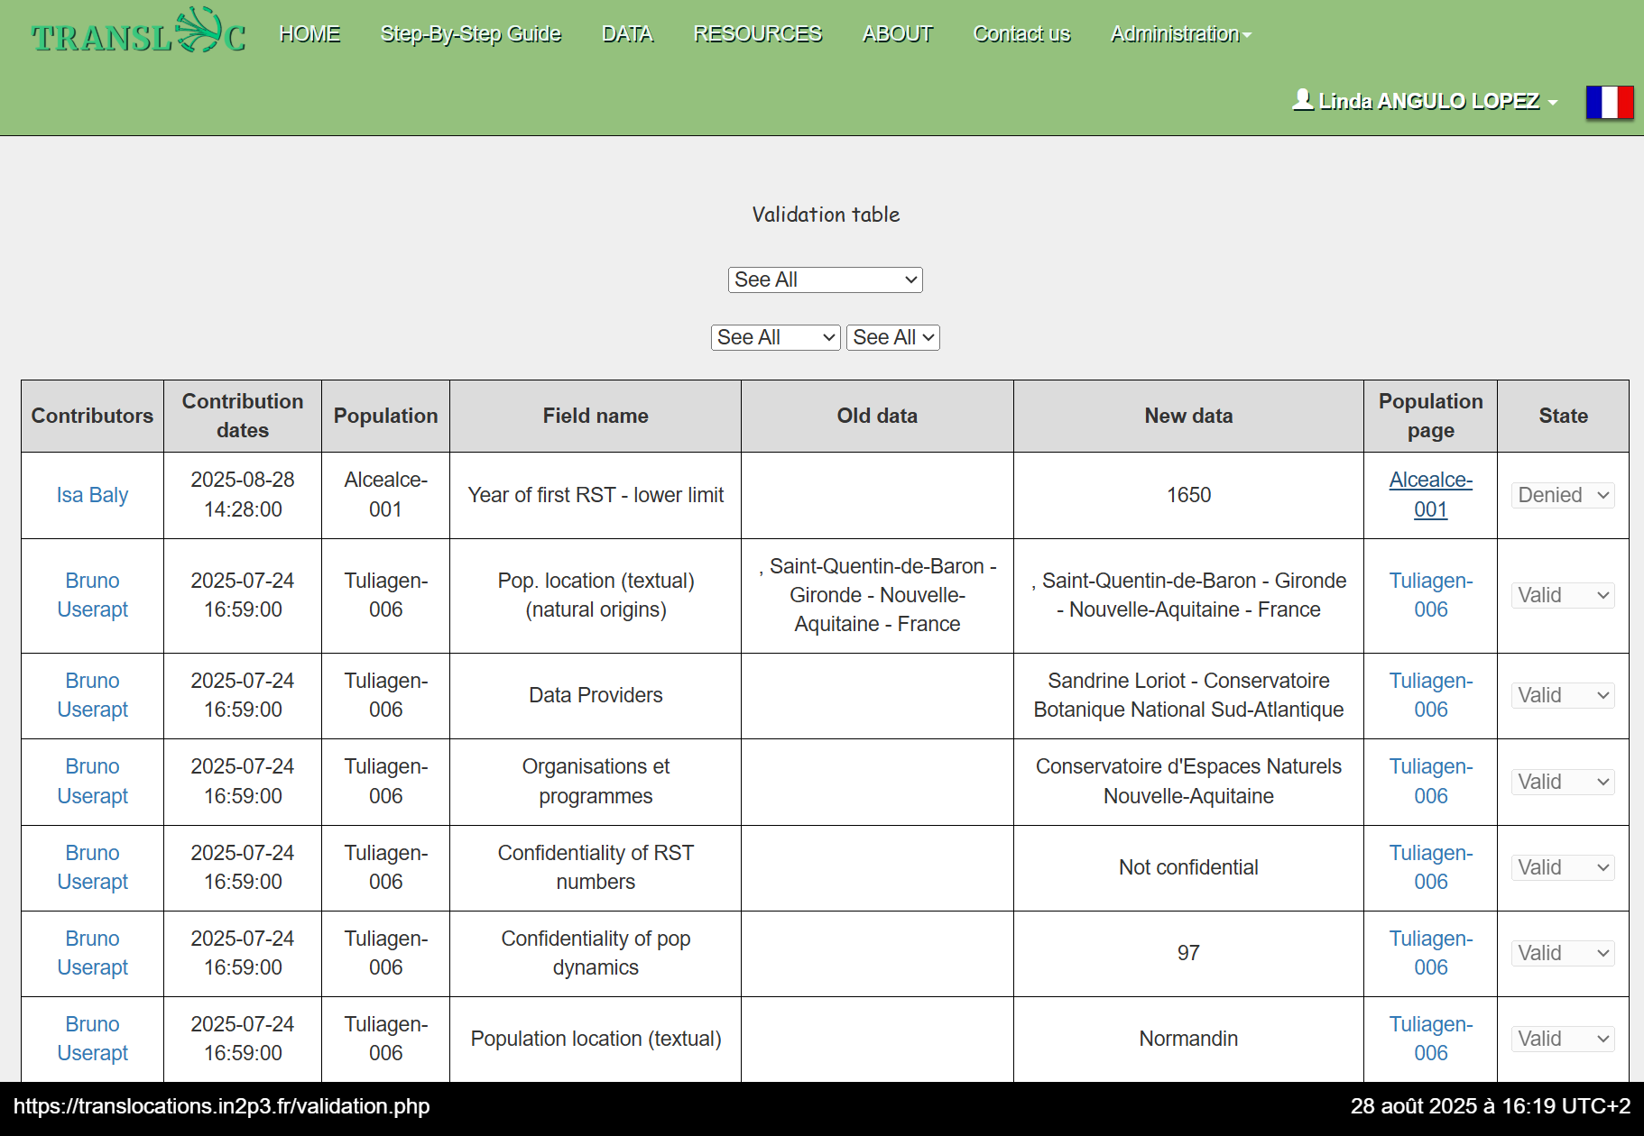
Contributor’s Data is Verified

Slide 12
Interoperability Through Referentials
Referentials make our data interoperable, ensuring consistency, integrity, and easy integration with other platforms.
GeoNames:
Standardized list of countries and locations
Our country list is based on GeoNames for global consistency
GBIF (Global Biodiversity Information Facility):
Provides species taxonomy and classification
Our species list is sourced from GBIF for compatibility with global biodiversity data

Slide 13
Data Import via Excel
Five model files are provided:
Basic data (species, location, year, translocation type)
RST (number of individuals translocated)
Post-translocation population sizes
Table of demographic progress
Viability table

Slide 14
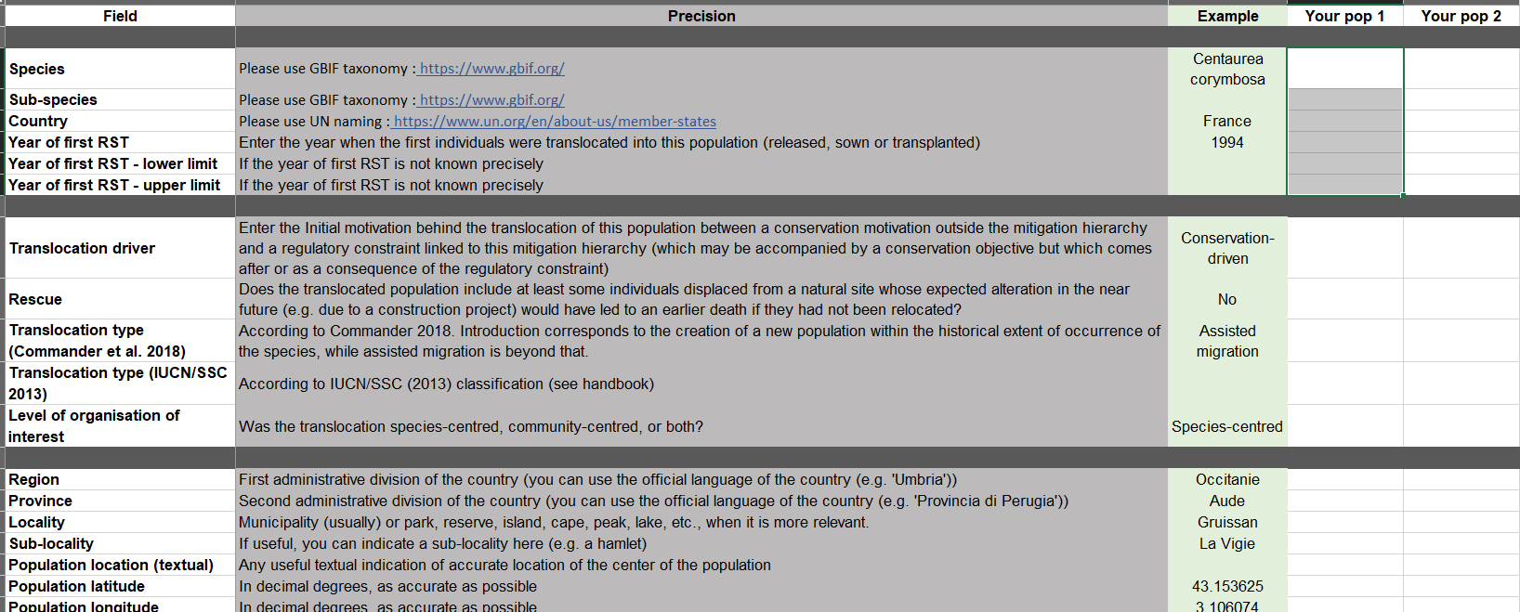
Excel Template - Basic Model

Slide 15
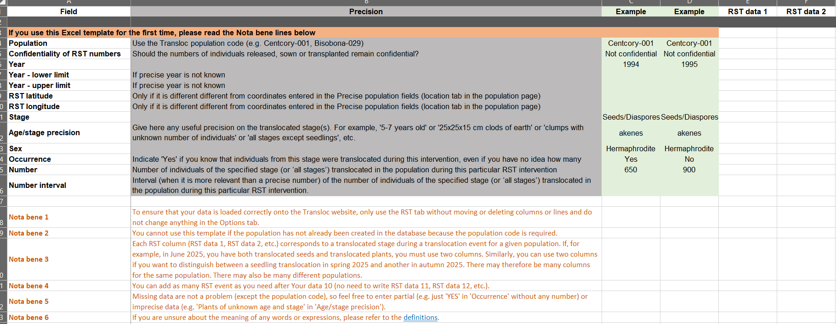
Excel Template - RST Model

Slide 16
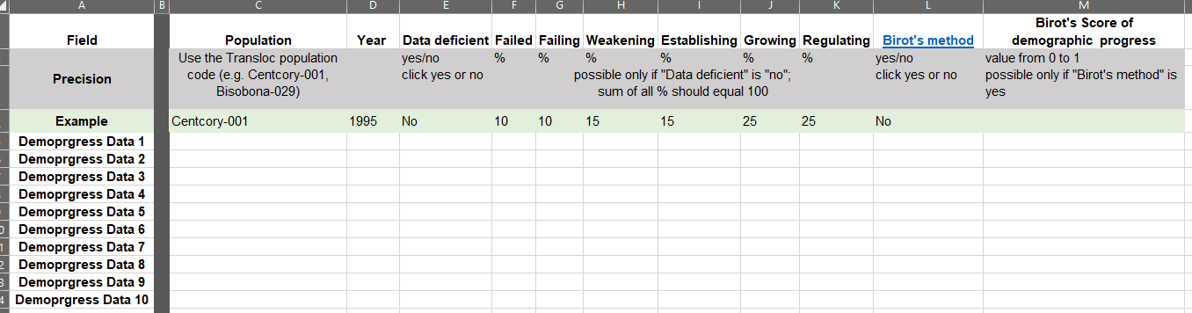
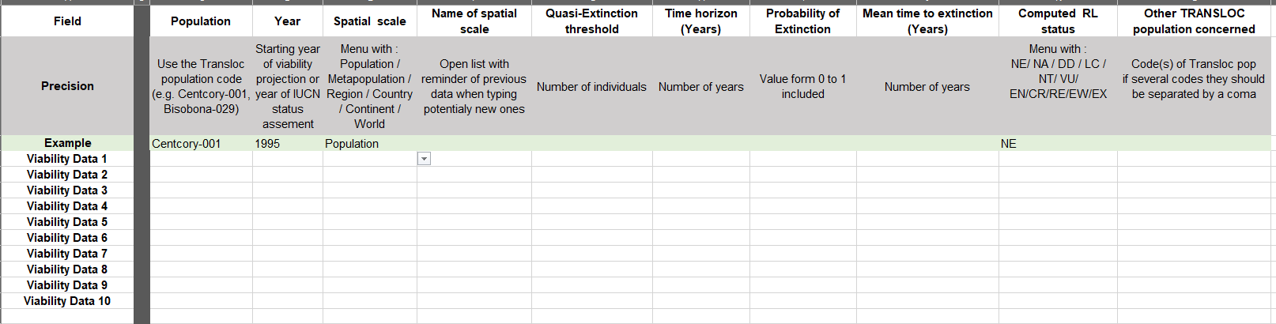
Excel Template
Demographic Progress
Excel Template - Viability

Slide 17
Pros & Cons Excel Import
Multiple populations can be included in a single file.
Over 170 fields can't be filled via Excel.
RST and Pop Dynamics files can only be uploaded for existing populations
Use web form to create new populations before.

Slide 18
Confidentiality & Data Protection
The personal contact details of users of the Transloc site services are not made visible and are not transmitted under any circumstances, by CNIL rules and regulations.
Confidential translocation data is handled and protected
Coordinates
Release Sowing Transplant
Population dynamics

Slide 19
Live Demonstration
+++
New Tables
Demographic Progress & Viability

Slide 20
Contact & Further Information
François Sarrazin – francois.sarrazin@mnhn.fr
Website: http://translocations.in2p3.fr/
Funded by Biodiversa+ with EU and national support
Collaboration across European universities and & institutes

